Slide 1

- (대학부) JBIG -

Slide 2

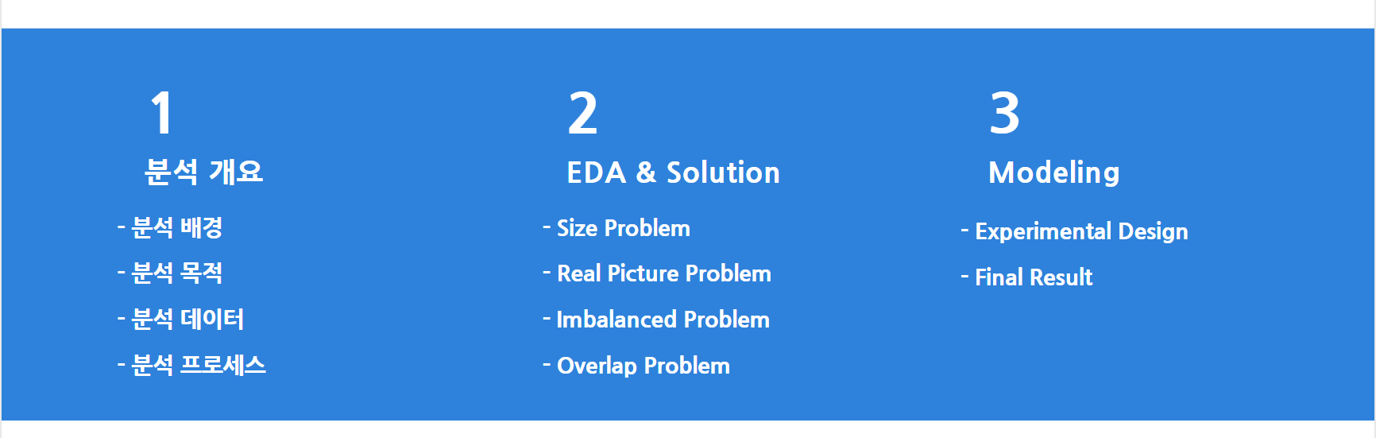
Contents

Slide 3
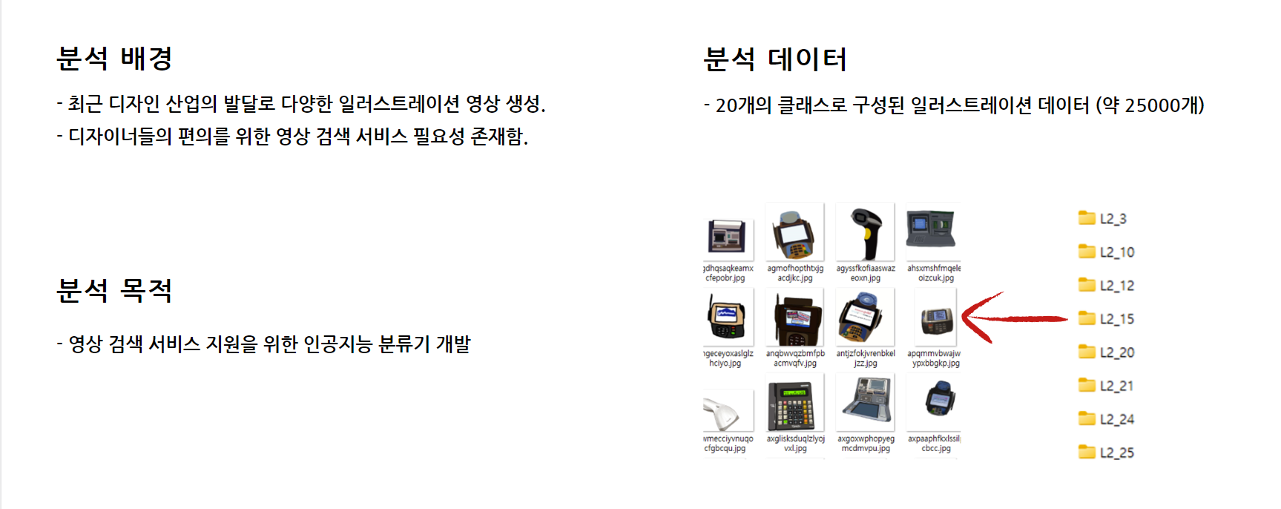
01. 분석 개요

Slide 4
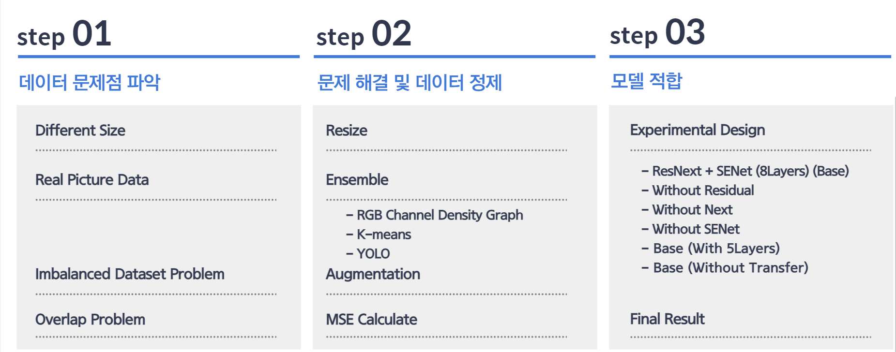
01. 분석 프로세스

Slide 5
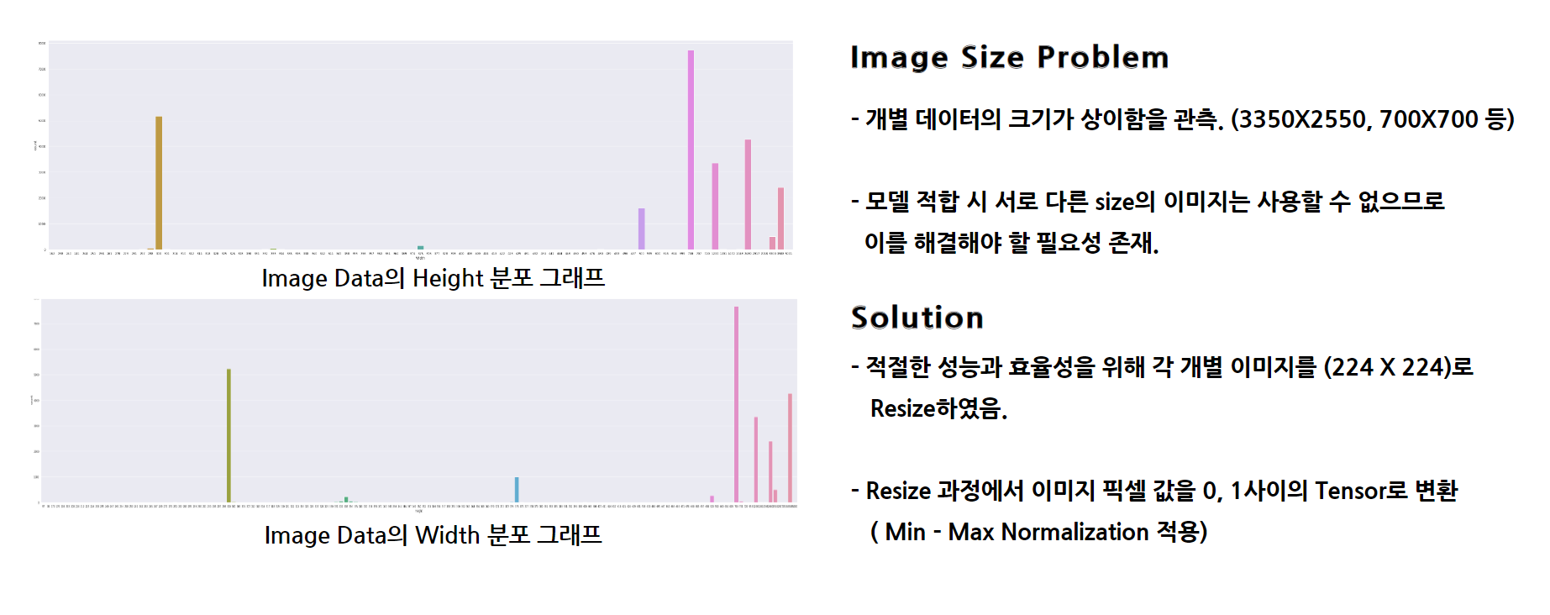
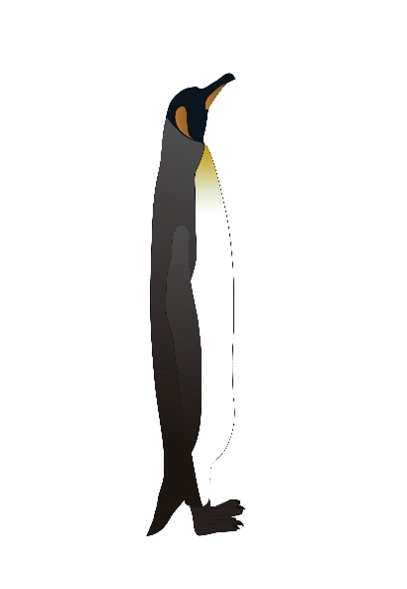



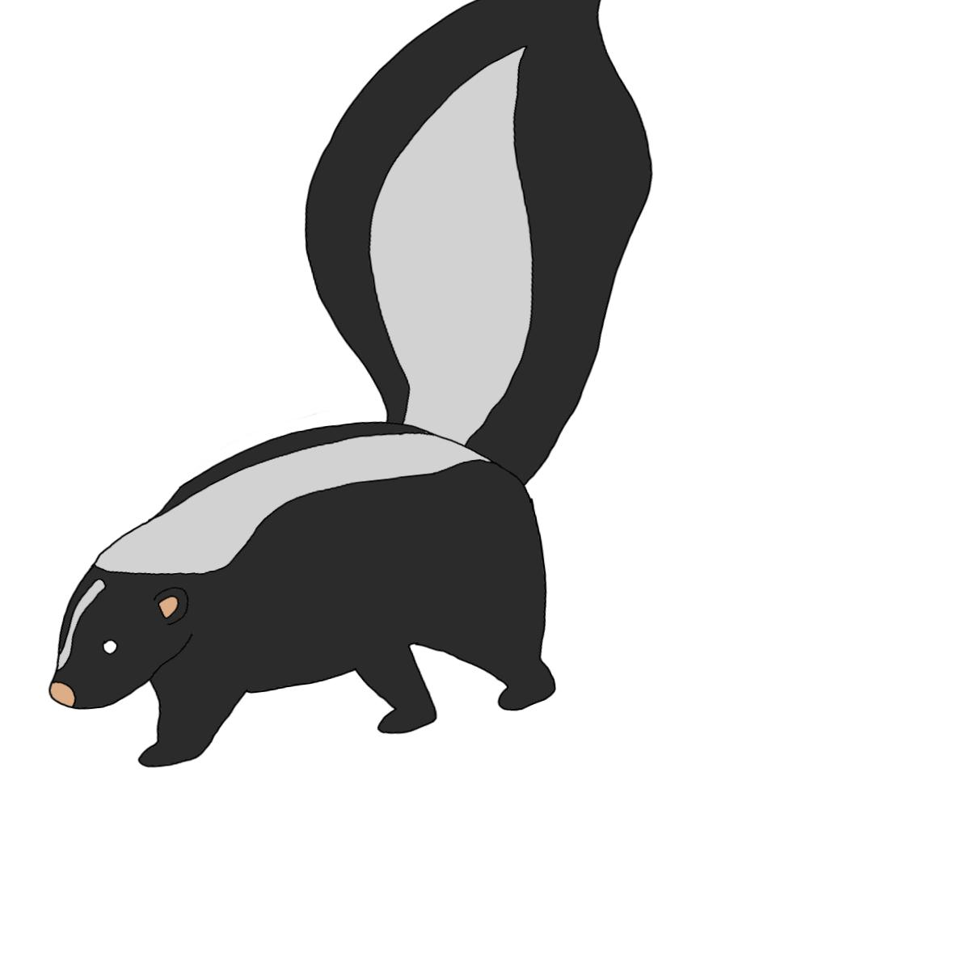
02. EDA & Solution (Size Problem)
Image Size
⦁ 개별 데이터의 크기가 상이한 것을 관측. (3350X2550, 700X700, 2480X3508 …)
⦁ 모델 적합 및 문제점 해결을 위해서 각 개별 이미지 (224 X 224)로 Resize하여 진행함.
⦁ 이때 이미지 내 각 픽셀 값이 0,1사이인 Tensor로 변환하였음 (min-max normalization 적용)

Slide 6
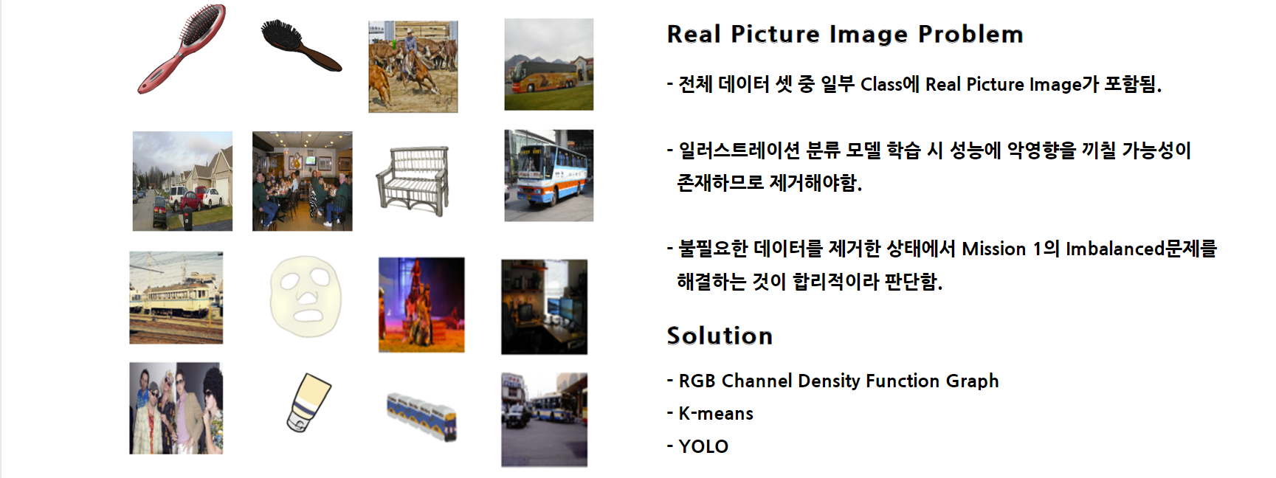
02. EDA & Solution (Real Picture Problem)

Slide 7
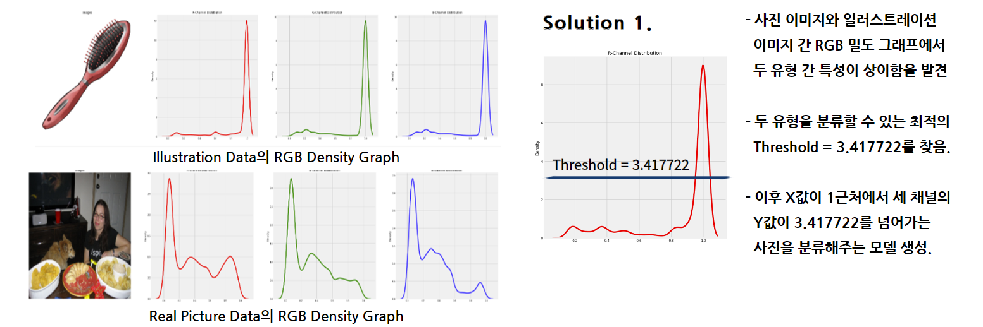
02. EDA & Solution (Real Picture Problem)

Slide 8
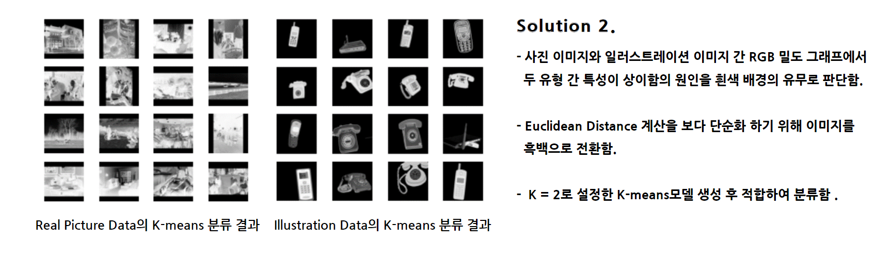
02. EDA & Solution (Real Picture Problem)

Slide 9
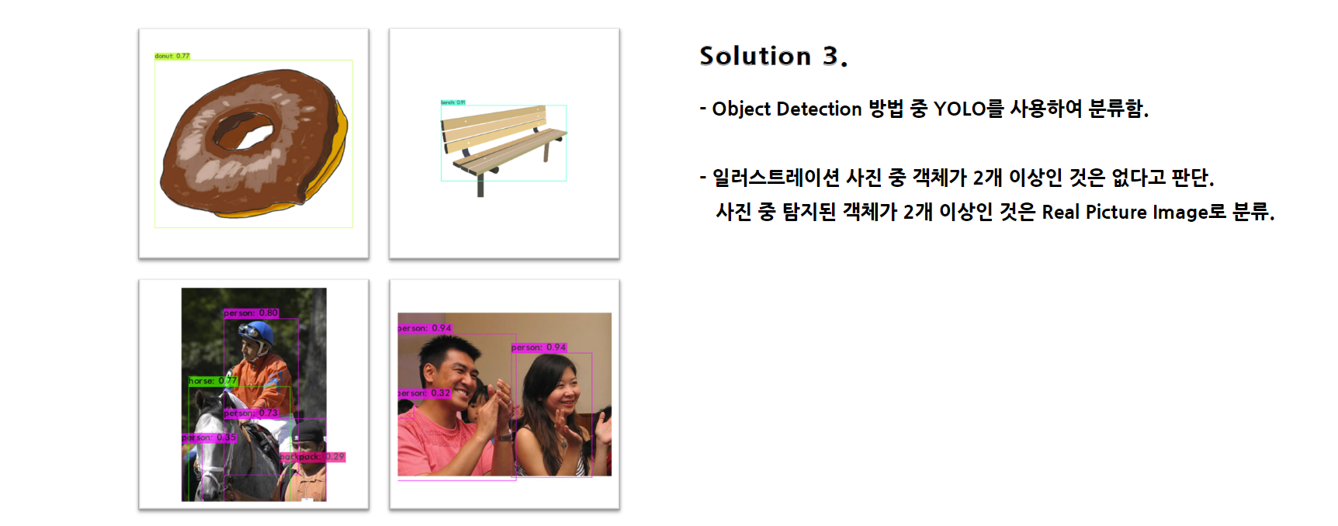
02. EDA & Solution (Real Picture Problem)

Slide 10
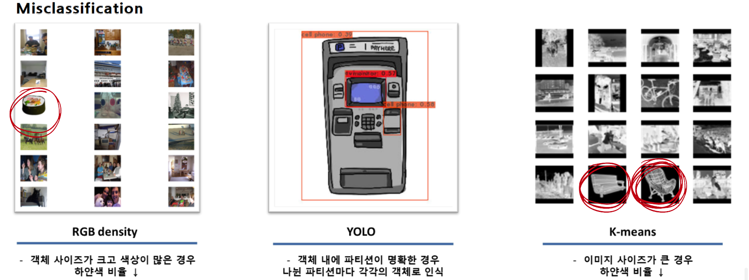
02. EDA & Solution (Real Picture Problem)

Slide 11
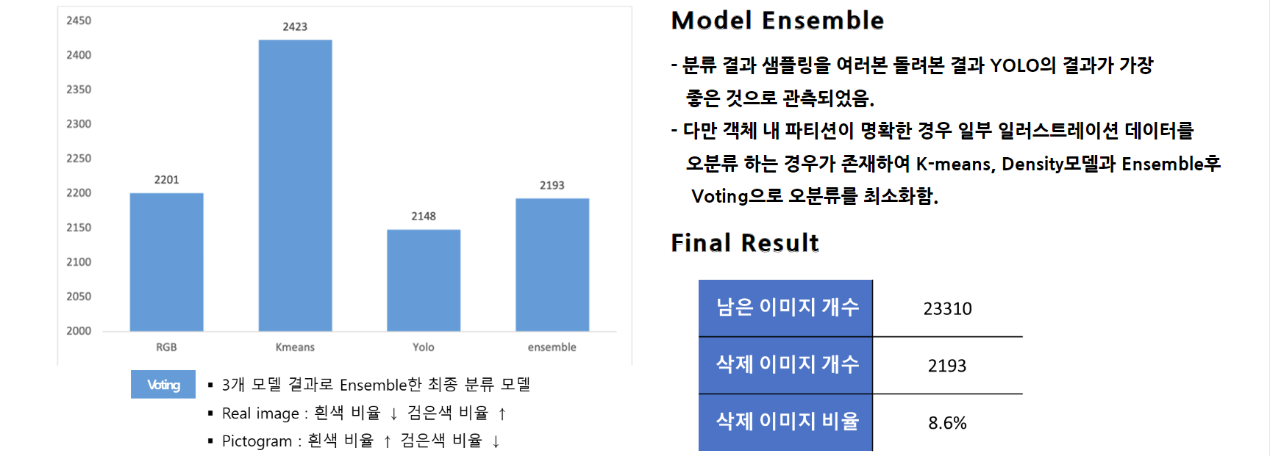
02. EDA & Solution (Real Picture Problem)

Slide 12
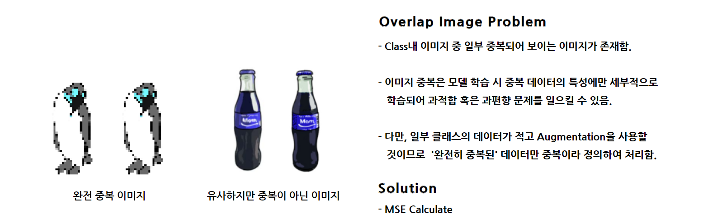
02. EDA & Solution (Overlap Problem)

Slide 13
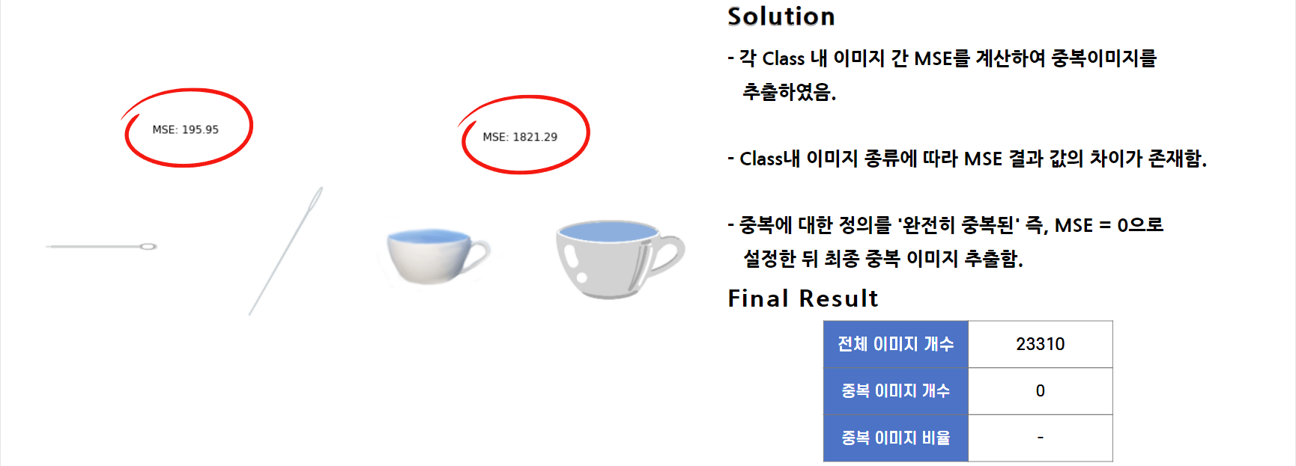
02. EDA & Solution (Overlap Problem)

Slide 14
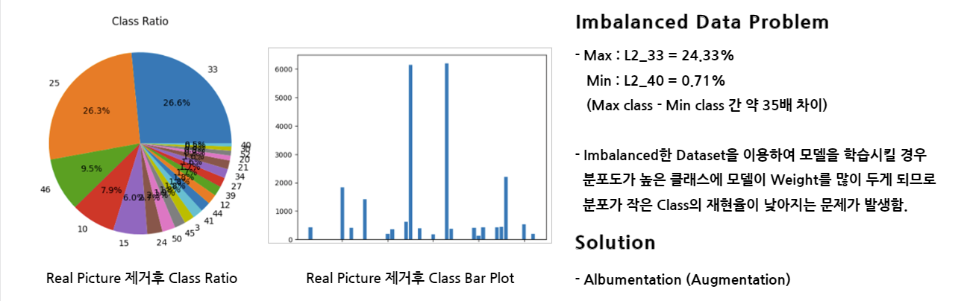
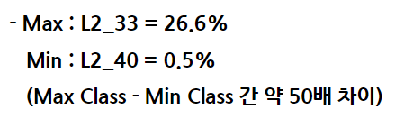
02. EDA & Solution (Imbalanced Problem)

Slide 15
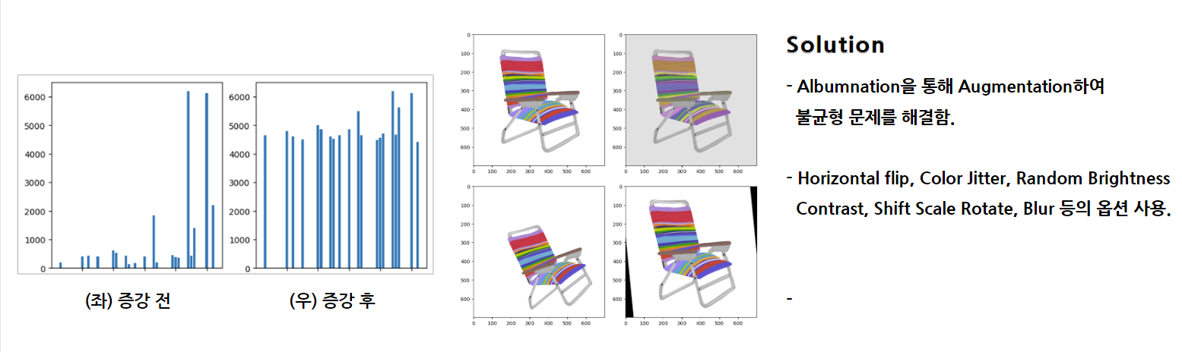
02. EDA & Solution (Imbalanced Problem)

Slide 16
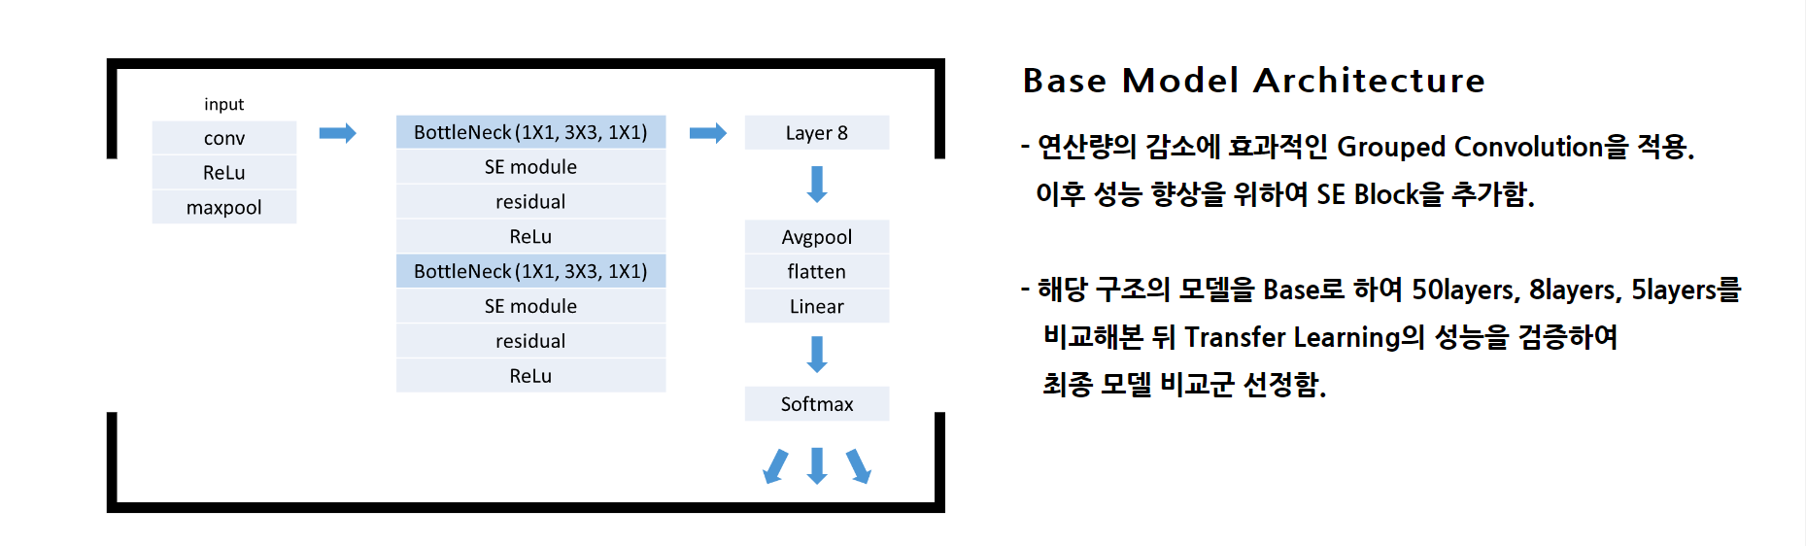
03. Modeling

Slide 17
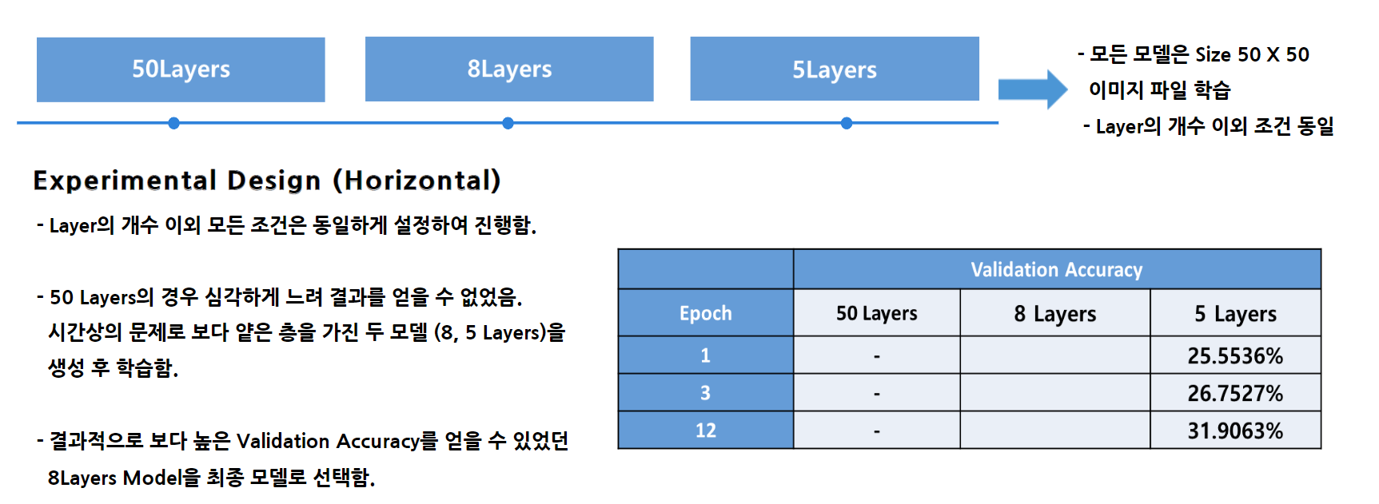
03. Modeling
 | Validation Accuracy
Epoch | 50 Layers | 8 Layers | 5 Layers
1 | - | 48.9488% | 25.5536%
3 | - | 59.6591% | 26.7527%
12 | - | - | 31.9063%

Slide 18
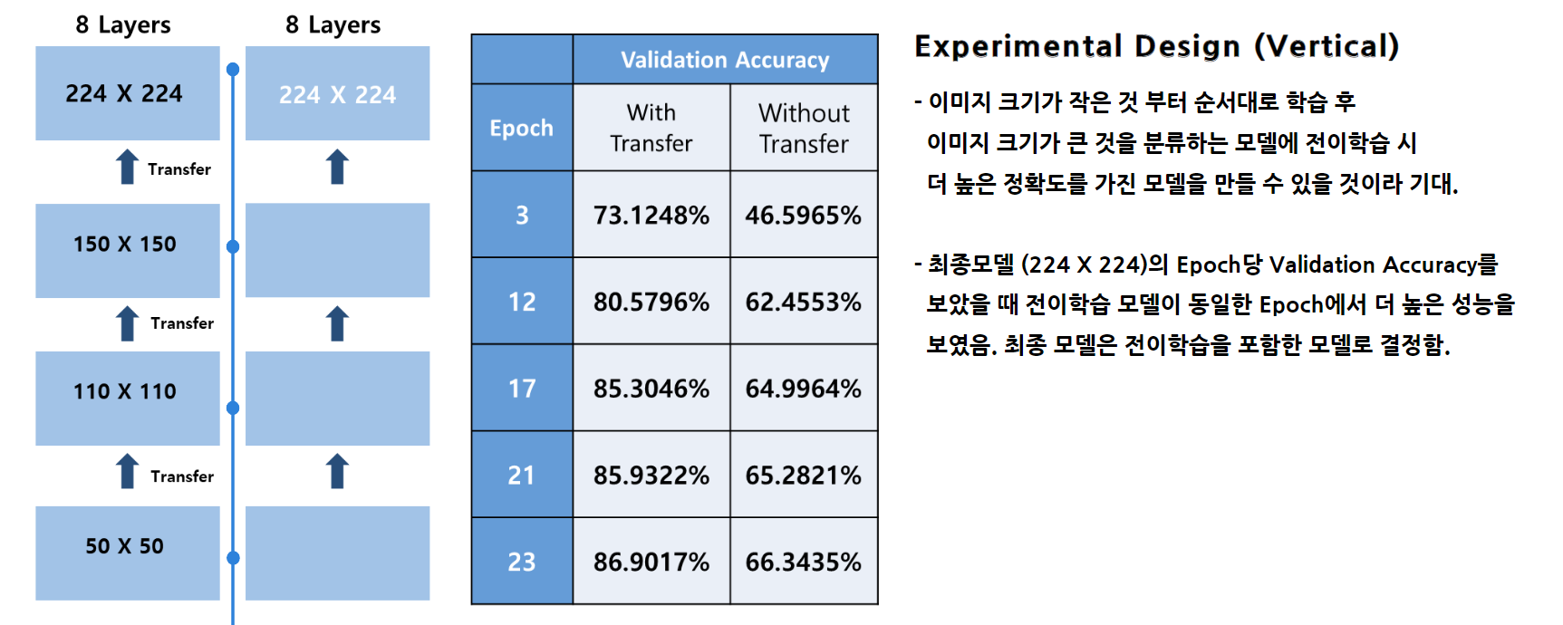
03. Modeling
 | Validation Accuracy
Epoch | With Transfer | Without Transfer
3 | 75.7985% | 46.5965%
12 | 81.9879% | 62.4553%
17 | 83.5850% | 64.9964%
21 | 82.7227% | 65.2821%
22 | 84.7688% | 66.3435%

Slide 19
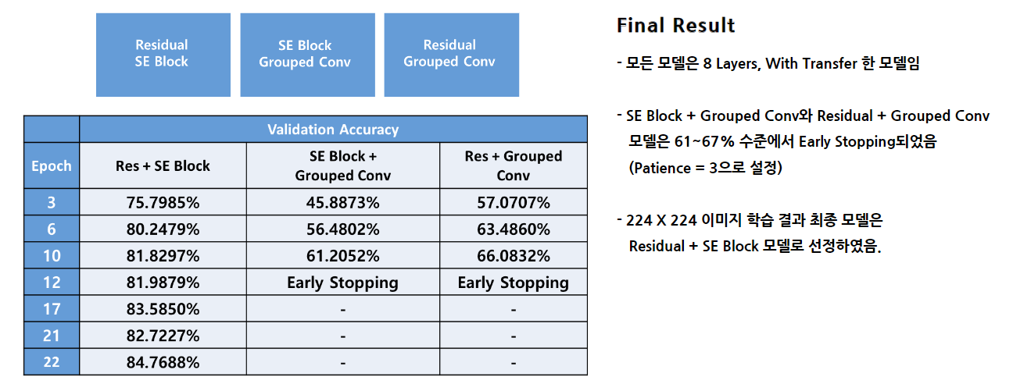
03. Modeling

Slide 20
